Slide 1


INSTITUTE FOR ADVANCED COMPUTING AND SOFTWARE DEVELOPMENT AKURDI, PUNE
"Seamless Deployments:Orchestrating AWS DevOps CI/CD with
GitHub, Jenkins, Ansible, and Docker"
Group No. 4
Chinmay Ghate (233411)
PROJECT GUIDE
MR.KARTIK AWARI
CENTRE COORDINATOR
MR.ROHIT PURANIK

Slide 2
Introduction
In a business world where time is money and every dollar counts, efficiency and productivity are critical
success factors. Continuous Integration (CI)/Continuous Deployment (CD) is a process that helps organizations
rapidly release software with confidence.
In these project we have use the Jenkins plugins which is as Publish Over SSH for the password less authentication.

Slide 3
Purpose
A pipeline is a process that drives software development through a path of building, testing, and deploying code, also known as CI/CD. By automating the process, the objective is to minimize human error and maintain a consistent process for how software is released.

Slide 4
Prerequisites
Machine | Installed Tool
Machine1 | Git
Machine2 | Jenkins
Machine3 | Ansible
Machine4 | Docker(web app)

Slide 5
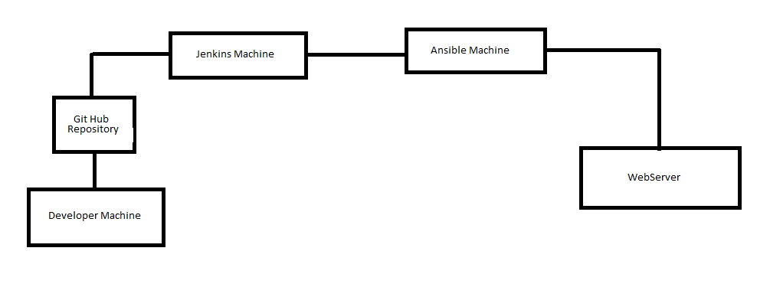
Project Overview

Slide 6
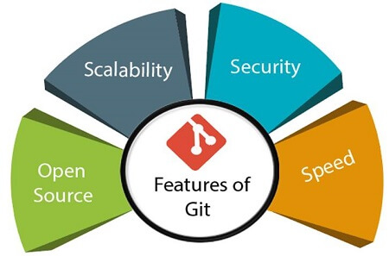
What is Git?
Git is an open-source distributed version control system. It is designed to handle minor to major projects with high speed and efficiency. It is developed to co-ordinate the work among the developers. The version control allows us to track and work together with our team members at the same workspace.
Features of Git:

Slide 7
What is Jenkins?
Jenkins is a self-contained, open source automation server which can be
used to automate all sorts of tasks related to building, testing, and delivering or deploying software. Jenkins is a powerful application that allows continuous integration and continuous delivery of projects, regardless of the platform you are working on. It is a free source that can handle any kind of build or continuous integration. You can integrate Jenkins with a number of testing and deployment technologies.
Jenkins Feature:
Extensible
Automation
Integrations
Extensibility
Test Customization
Processes and Workflow

Slide 8
Jenkins Publish Over SSH Plugin:
This plugin includes a builder which enables the use of the publisher during the build process. This means that you can send newly created packages to a remote server and install them, start and stop services that the build may depend on and many other use cases.
Feature:
• SCP - Send files over SSH (SFTP).
• Execute commands on a remote server (can be disabled for a server configuration, or for the whole plugin).
• Use username and password (keyboard-interactive) or public key authentication
Passwords/passphrases are encrypted in the configuration files and in the UI.
• SSH SFTP/ SSH Exec can be used as a build step during the build process (Freestyle and Matrix projects).
• Optionally retry if the transfer of files fails.

Slide 9
Ansible:
Ansible is an agentless automation tool that you install on a single host (referred to as the control node). F
From the control node, Ansible can manage an entire fleet of machines and other devices (referred to as managed nodes) remotely with SSH, Power shell remoting, and numerous other transports, all from a simple command-line interface with no databases or daemons required.
Ansible is a suite of software tools that enables infrastructure as code. It is open-source and the suite includes software provisioning, configuration management, and application deployment functionality.

Slide 10
Ansible Playbook
They contain Plays (which are the basic unit of Ansible execution). This is both an ‘execution concept’ and how we describe the files on which ansible-playbook operates. Playbooks are written in YAML and are easy to read, write, share and understand. To learn more about playbooks, see Ansible playbooks.
Ansible Playbooks offer a repeatable, re-usable, simple configuration management and multi-machine deployment system, one that is well suited to deploying complex applications. If you need to execute a task with Ansible more than once, write a playbook and put it under source control.
Then you can use the playbook to push out new configuration or confirm the configuration of remote systems. The playbooks in the ansible-examples repository illustrate many useful techniques

Slide 11
Docker
Docker is a platform that enables developers to automate the deployment, scaling, and management of applications using containerization technology. Containers are lightweight, portable, and self-sufficient units that encapsulate an application and all its dependencies, including libraries, runtime, and settings, ensuring consistent behavior across different environments.

Slide 12
WebServer(Apache):
What is Apache Webserver?
Apache HTTP Server is a free and open-source web server that delivers web content through the internet. It is commonly referred to as Apache and after development, it quickly became the most popular HTTP client on the web.
It’s widely thought that Apache gets its name from its development history and process of improvement through applied patches and modules but that was corrected back in 2000. It was revealed that the name originated from the respect of the Native American tribe for its resiliency and durability.
Why Apache Webserver?
Apache is considered open source software, which means the original source code is freely available for viewing and collaboration. Being open source has made Apache very popular with developers who have built and configured their own modules to apply specific functionality and improve on its core features

Slide 13
Feature of Apache Webserver
Handling of static files
Loadable dynamic modules
Auto-indexing
.htaccess
Compatible with IPv6
Supports HTTP/2
FTP connections
Gzip compression and decompression
Bandwidth throttling

Slide 14
How does the Apache Webserver work?
Apache functions as a way to communicate over networks from client to server using the TCP/IP protocol. Apache can be used for a wide variety of protocols, but the most common is HTTP/S. HTTP/S or Hyper Text Transfer Protocol (S stands for Secure) is one of the main protocols on the web, and the one protocol Apache is most known for.
HTTP/S is used to define how messages are formatted and transmitted across the web, with instructions for browsers and servers on how to respond to various requests and commands. Hypertext Transfer Protocol Secure is usually through port 443 with the unsecured protocol being through port 80.
The Apache server is configured via config files in which modules are used to control its behavior. By default, Apache listens to the IP addresses configured in its config files that are being requested. This is where one of Apaches many strengths come into play.

Slide 15
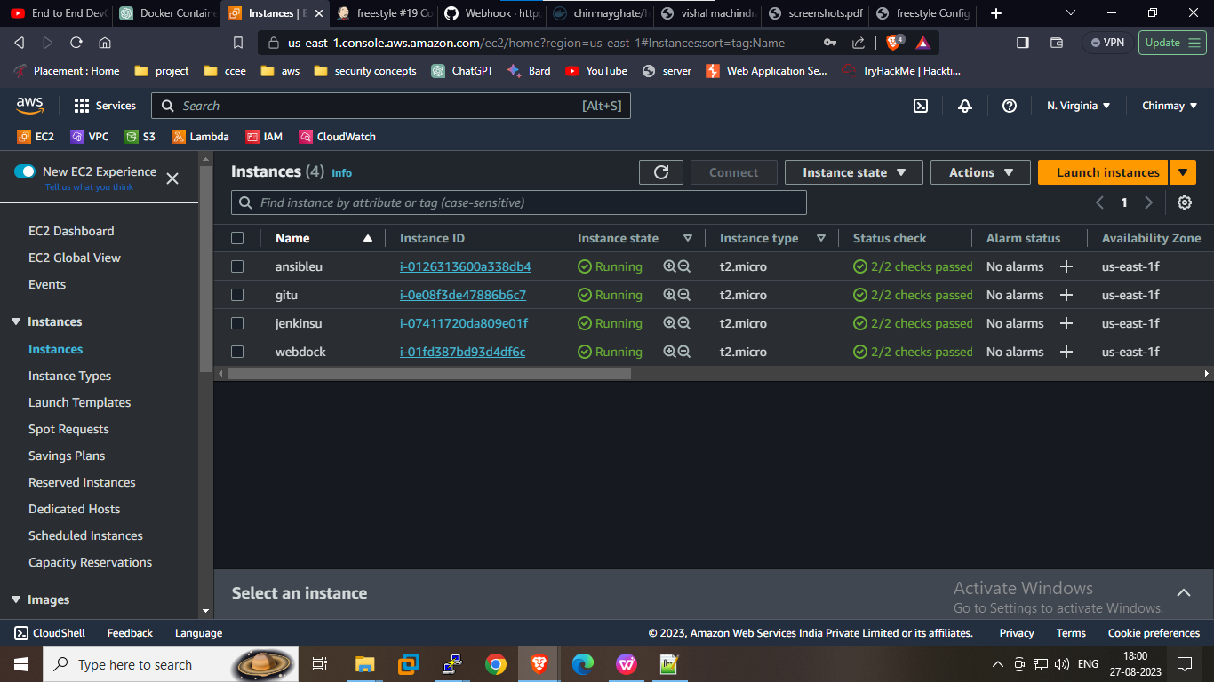
Machine’s:

Slide 16
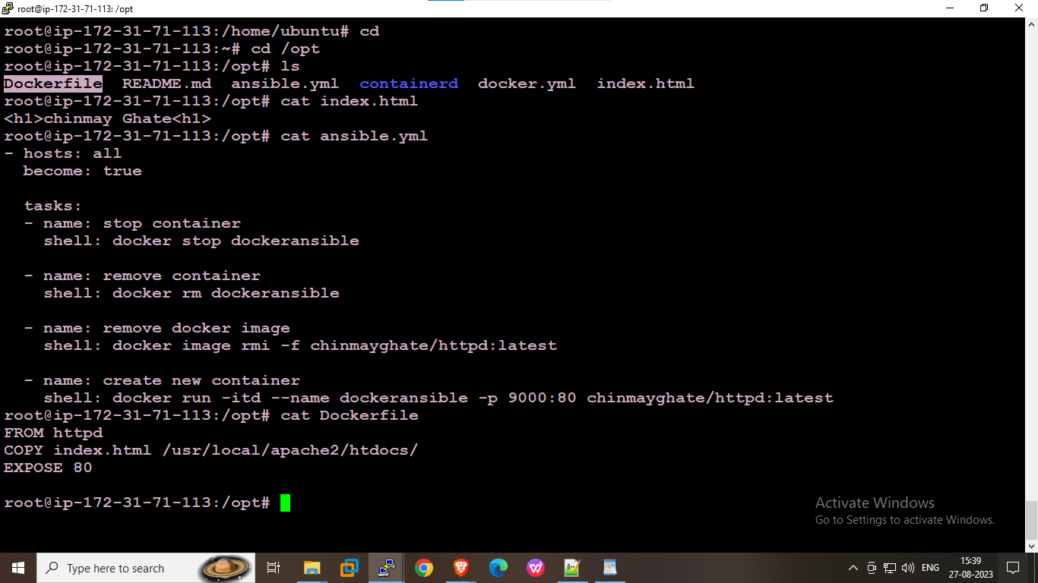
Playbook Configuration at Ansible Machine:

Slide 17
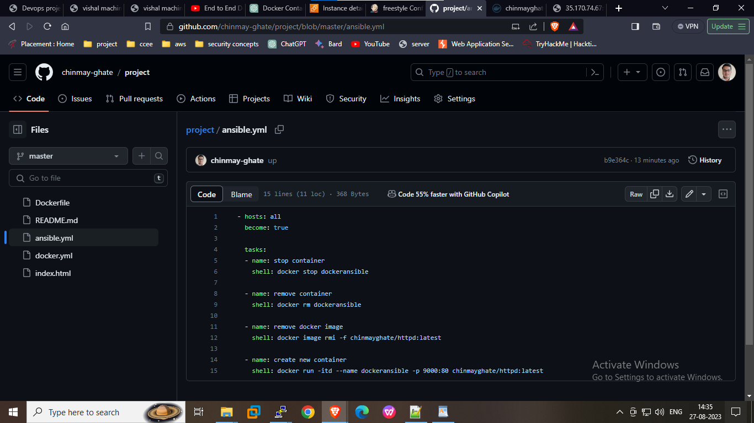
Github Repository:

Slide 18
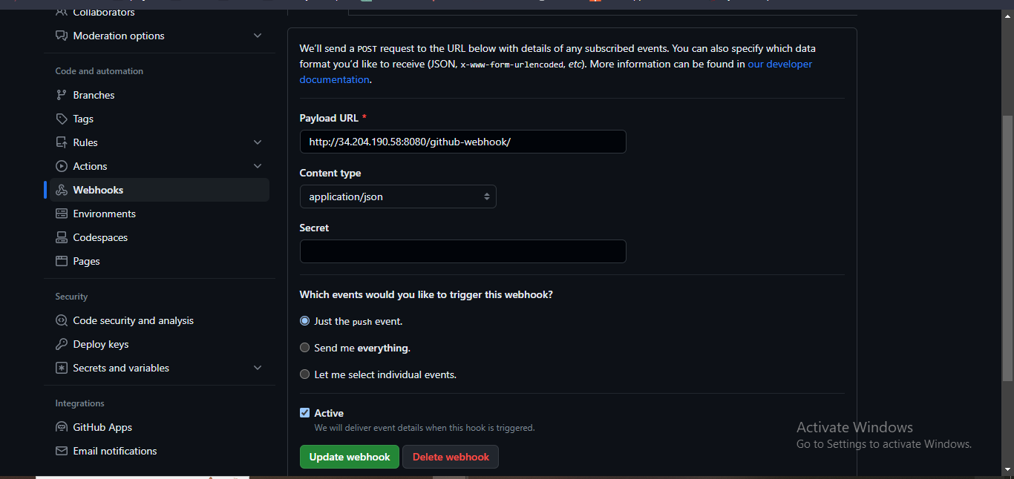
Webhook:

Slide 19
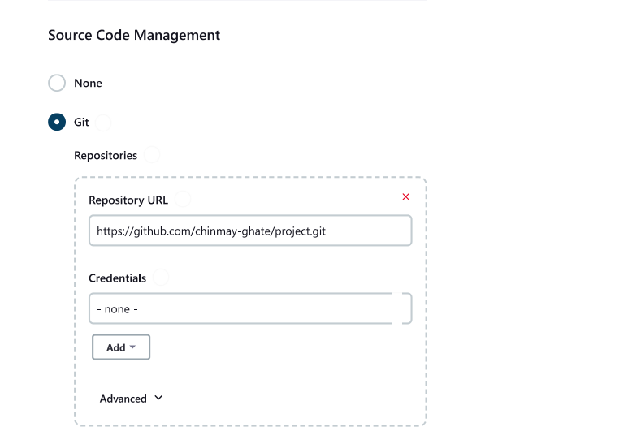
Adding GitHub repository with SCM:

Slide 20
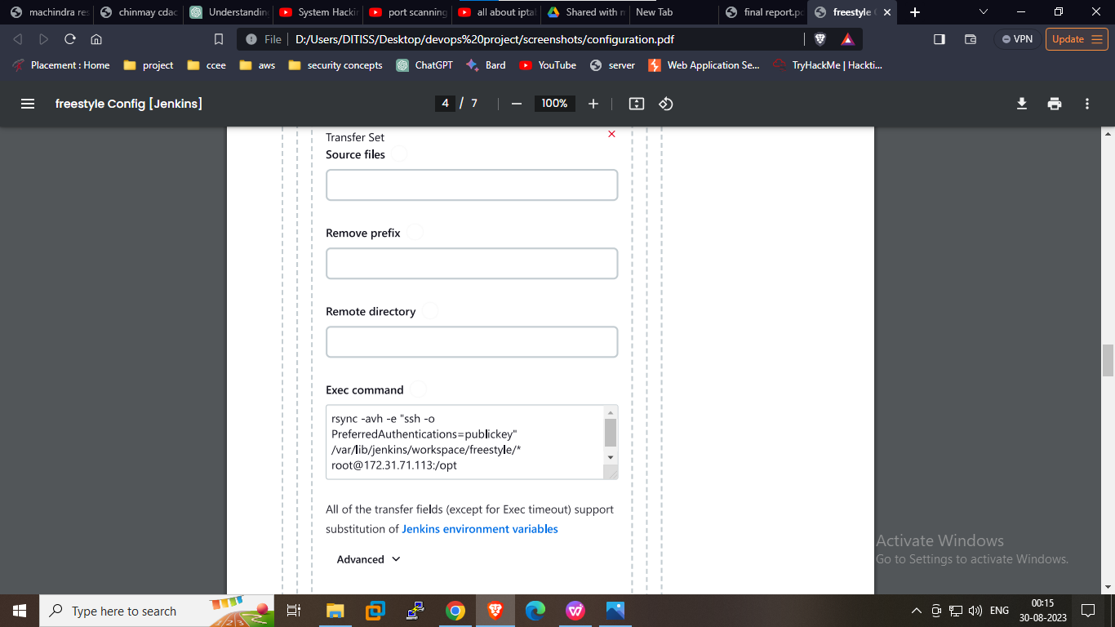
Build Step for Jenkins:

Slide 21
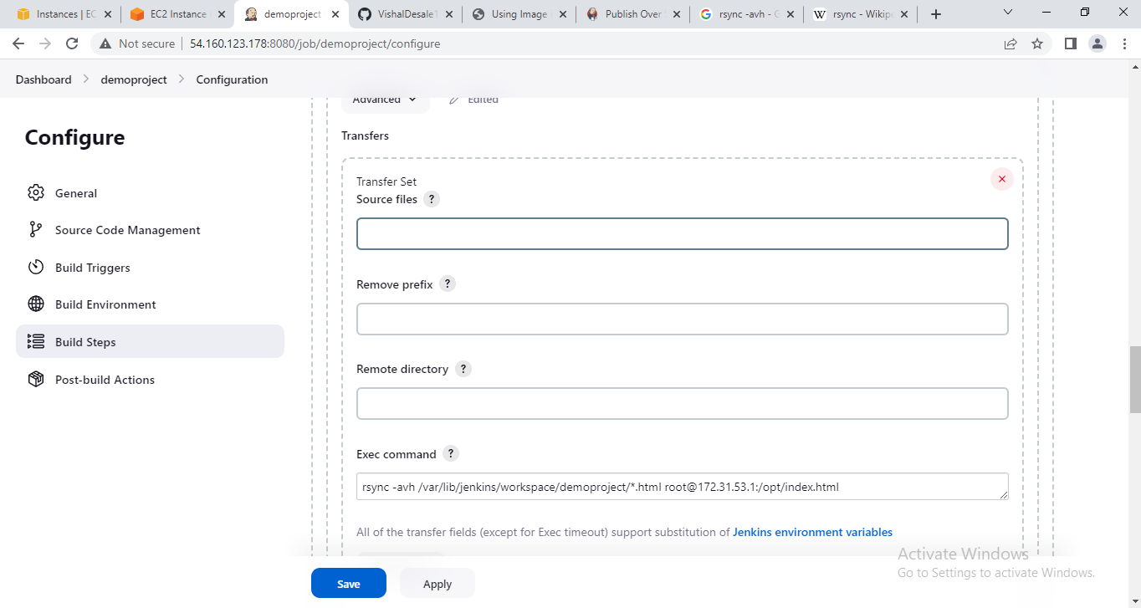
Build Step for Jenkins:

Slide 22
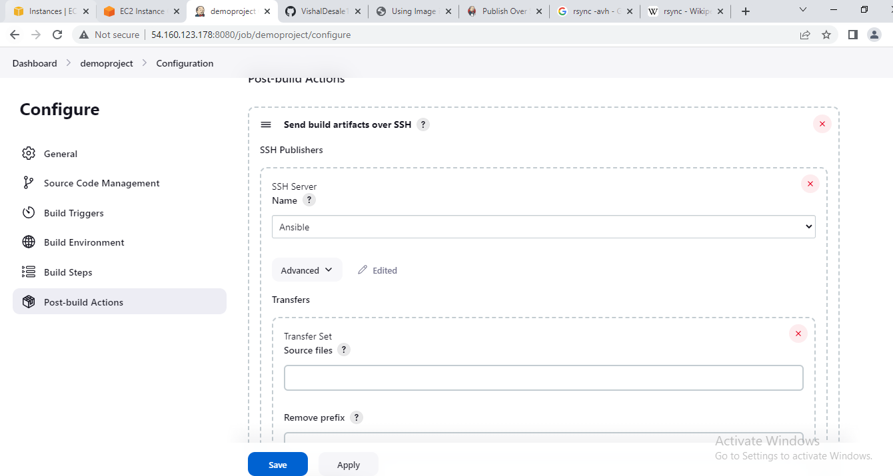
Post-Build Action for Ansible:

Slide 23
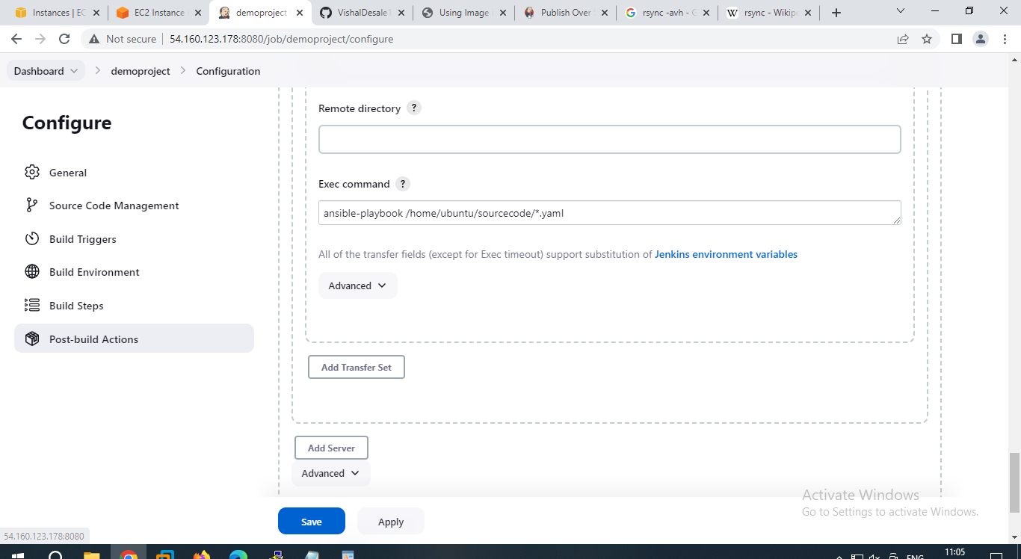
Post-Build Action for Ansible:
Post-Build Action for Ansible

Slide 24
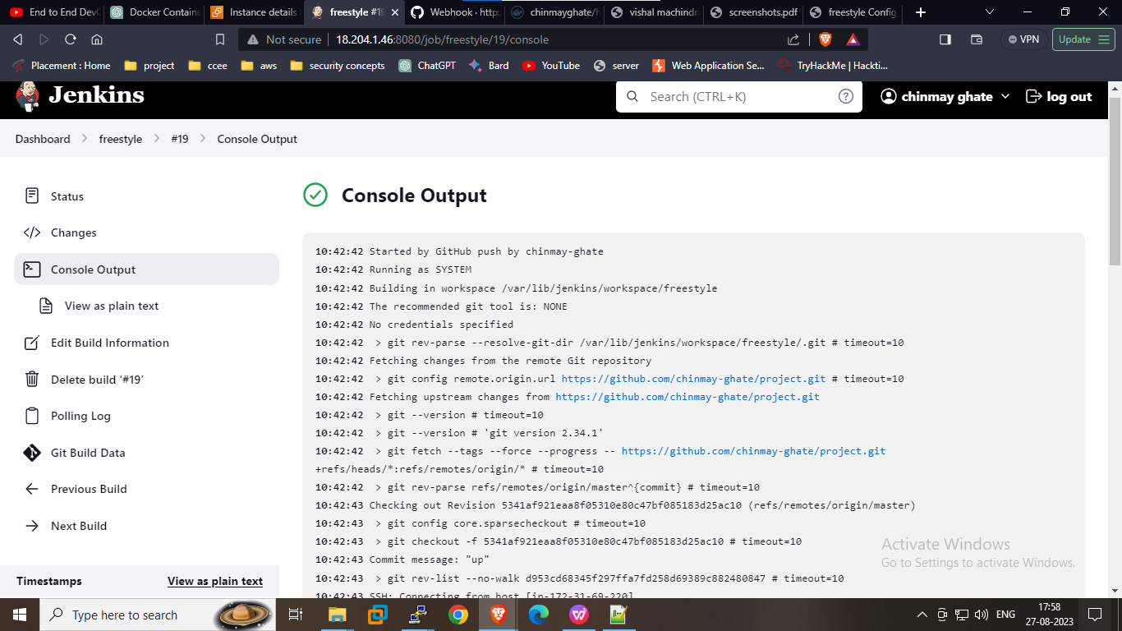
Console Output:

Slide 25
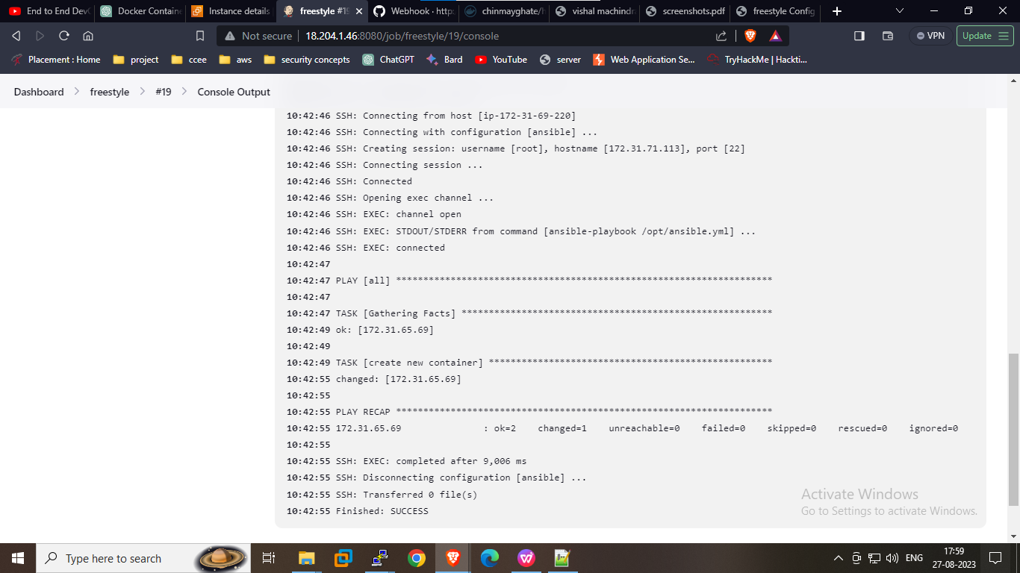
Console Output:

Slide 26
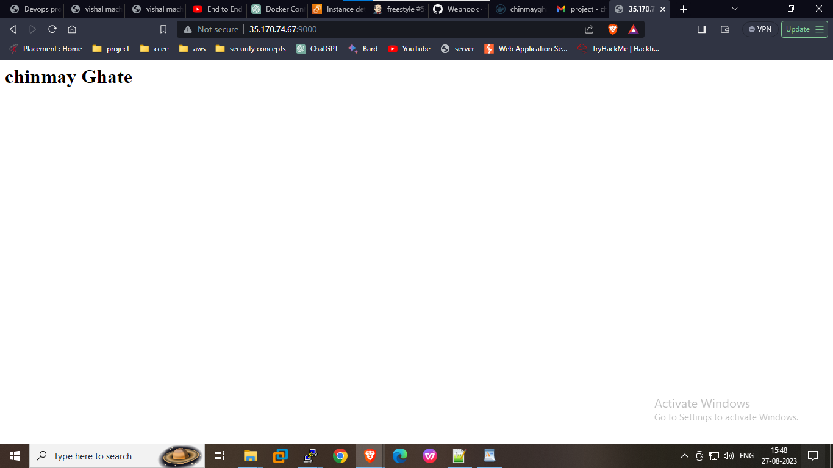
Output:

Slide 27
References
•https://www.javatpoint.com/git
•https://www.youtube.com/watch?v=Ri-URt8gPCk
•https://www.jenkins.io/doc/
•https://www.ansible.com/
•https://plugins.jenkins.io/publish-over-ssh/
•https://www.youtube.com/watch?v=nplH3BzKHPk

Slide 28


